Slide 1
.NET Aspire y Dapr, dos SuperSaiyan para desarrollar aplicaciones multi-cloud

Slide 3








Nosotros
Santiago Porras Rodríguez
Sergio Parra Guerra
Santiago Parra
Solutions Architect & Frontend Lead at Encamina
@saintwukong
Software & Cloud Architect at Encamina
@sparraguerra
Software & Cloud Architect at Encamina

Slide 4
Pensamos en colores
Es la actitud fresca, optimista y comprometida que utiliza el ingenio y la creatividad para encontrar soluciones de tecnología y talento que mejoren el presente de las personas, la empresa y nuestra sociedad.

Slide 5
Let’s Play!
What’s Aspire .NET?
What’s Dapr?

Slide 6
Aspire .NET (Distributed Application Runtime)
https://learn.microsoft.com/en-us/dotnet/aspire/get-started/aspire-overview

Slide 7
Cloud Native
Problems to solve
Complex
Getting Started
Choices
Paved Path
Notes:
¡Claro! .NET Aspire es una pila tecnológica diseñada para facilitar la creación de aplicaciones distribuidas y listas para producción en la nube. Aquí te dejo los puntos más importantes:
Orquestación de Aplicaciones: .NET Aspire simplifica la gestión de la configuración y las interconexiones de las aplicaciones en entornos de desarrollo locales¹. Esto incluye la gestión de variables de entorno y configuraciones de contenedores.
Integraciones: Ofrece paquetes NuGet para servicios populares como Redis y PostgreSQL, asegurando que se conecten de manera consistente y sin problemas con tu aplicación¹.
Plantillas y Herramientas: Proporciona plantillas de proyectos y herramientas para Visual Studio, Visual Studio Code y la CLI de .NET, facilitando la creación y gestión de proyectos .NET Aspire¹.
Panel de Control: Incluye un panel de control que permite monitorear y gestionar las aplicaciones de manera centralizada².
Observabilidad y Resiliencia: Integra herramientas para la observabilidad y la resiliencia de las aplicaciones, como OpenTelemetry para el monitoreo y la telemetría¹.
Despliegue: Facilita el despliegue en entornos de producción, incluyendo la integración con Azure y otros servicios en la nube¹.
Estos componentes hacen de .NET Aspire una opción robusta para desarrollar aplicaciones modernas y escalables. ¿Hay algún aspecto específico que te gustaría explorar más a fondo?

Slide 8
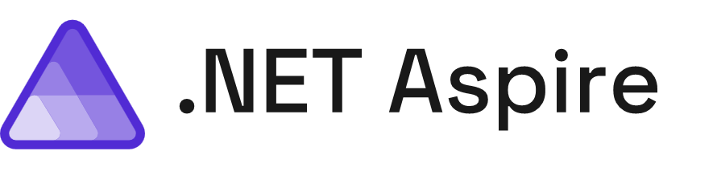
A cloud ready stack for building observable, production ready, distributed applications

Slide 9
Get Started

Slide 10
Prerequisites
.NET 8.0 or .NET 9.0.
.NET Aspire SDK
An OCI compliant container runtime, such as:
Docker Desktop or Podman. For more information, see Container runtime.
An Integrated Developer Environment (IDE) or code editor, such as:
Visual Studio 2022 version 17.9 or higher (Optional)
Visual Studio Code (Optional)
C# Dev Kit: Extension (Optional)
JetBrains Rider with .NET Aspire plugin (Optional)
Notes:
In the context of .NET, a workload refers to a set of optional components and tools that can be installed on top of the .NET SDK. These workloads provide support for various application types and scenarios. Let me break it down for you:
What is a Workload?
A workload is a collection of tools, libraries, and templates that cater to specific development needs.
Workloads are designed to enhance your development experience by providing targeted functionality.
They can include features related to specific frameworks, platforms, or application types.
Installing Workloads:
You can use the dotnet workload install command to install one or more optional workloads.
These workloads extend the capabilities of the .NET SDK.
For example, if you’re building a .NET MAUI app or a Blazor WebAssembly AOT project, you can install the relevant workloads to streamline your development process¹².
How to Use Workloads:
To explore available workloads, you can use the dotnet workload search command.
Once you identify the workload you need, install it using the dotnet workload install <WORKLOAD_ID> syntax.
Workloads can provide support for cross-platform development, specific frameworks, and other specialized scenarios.
Manifests and Versioning:
Workload installation relies on manifests that maintain information about required assets.
The dotnet workload install command downloads the latest manifests before installing a workload.
These manifests help locate and download the necessary components.
Additionally, newer-version notifications are available starting in .NET 6, ensuring you stay up-to-date with workload versions¹.
Remember that workloads are optional, and you can choose the ones that align with your development goals. Whether you’re building web apps, mobile apps, or other types of applications, workloads provide a tailored development experience! 🚀

Slide 11
Install Workload
Steps to install Aspire in command line
1) dotnet workload list
2) dotnet workload update
dotnet workload install aspire
3) dotnet workload list
Using Visual Studio 2022 17.9 or higher

Slide 12
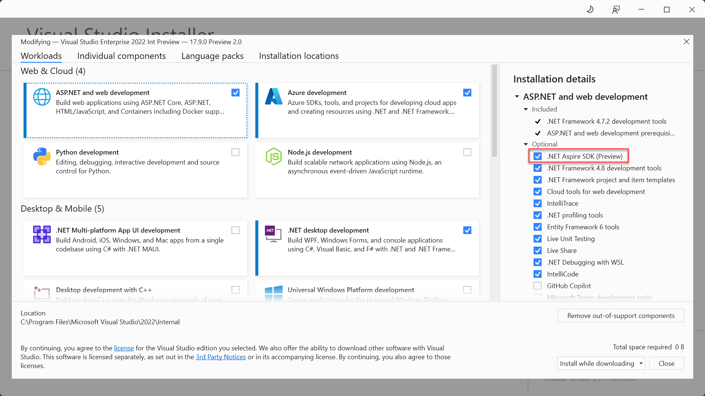
Install Workload
Steps to install using Visual Studio

Slide 13
Fundamentals

Slide 14
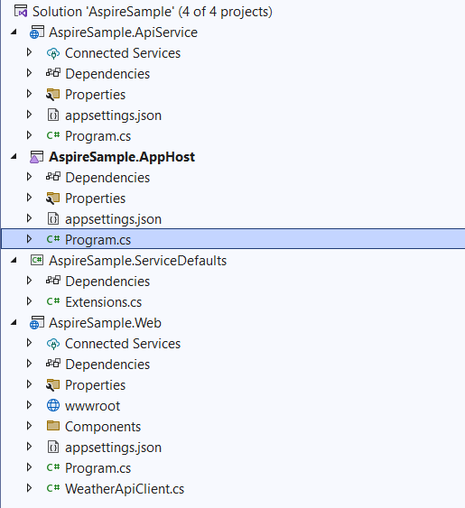
Project Structure
AppHost Project
ServiceDefaults Project

Slide 15
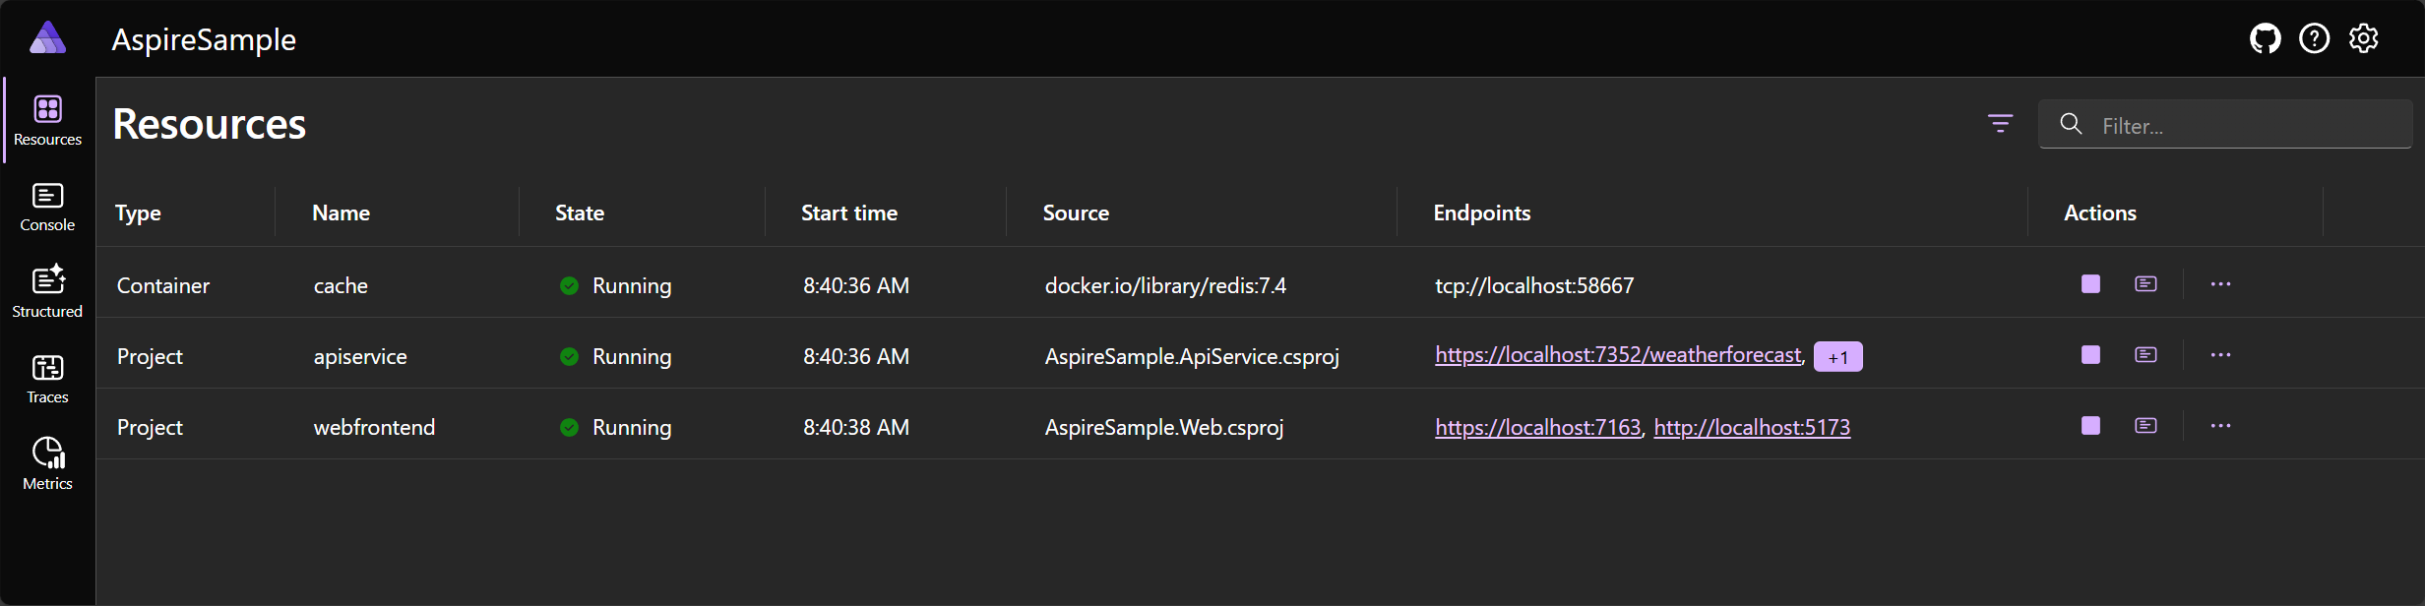
Developer Dashboard

Slide 16
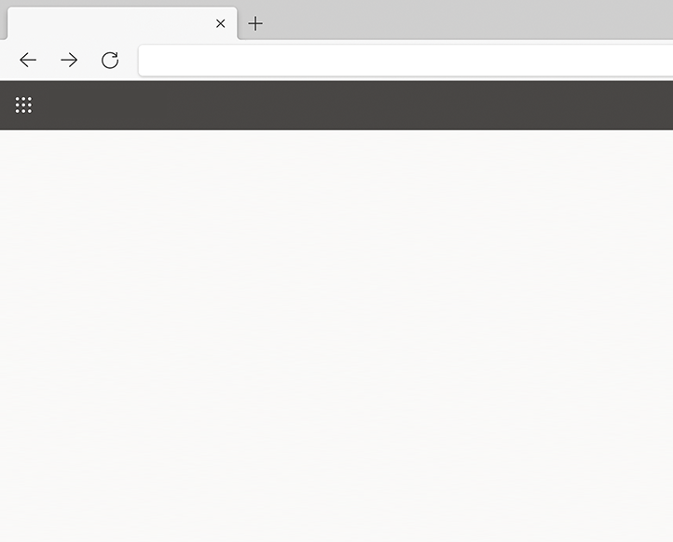

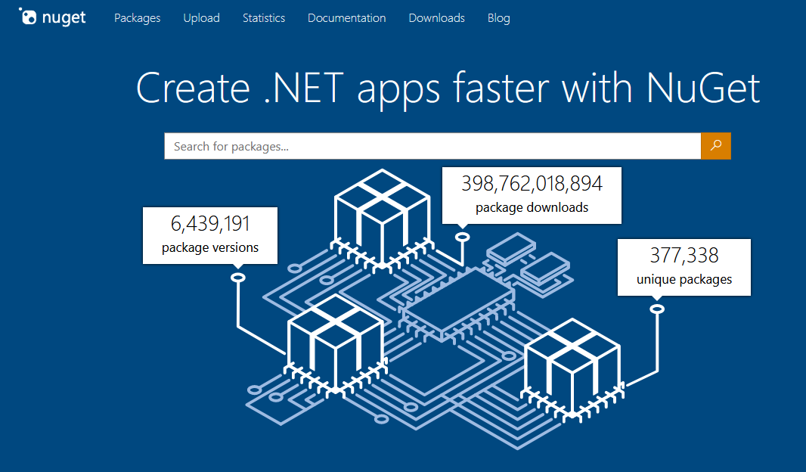
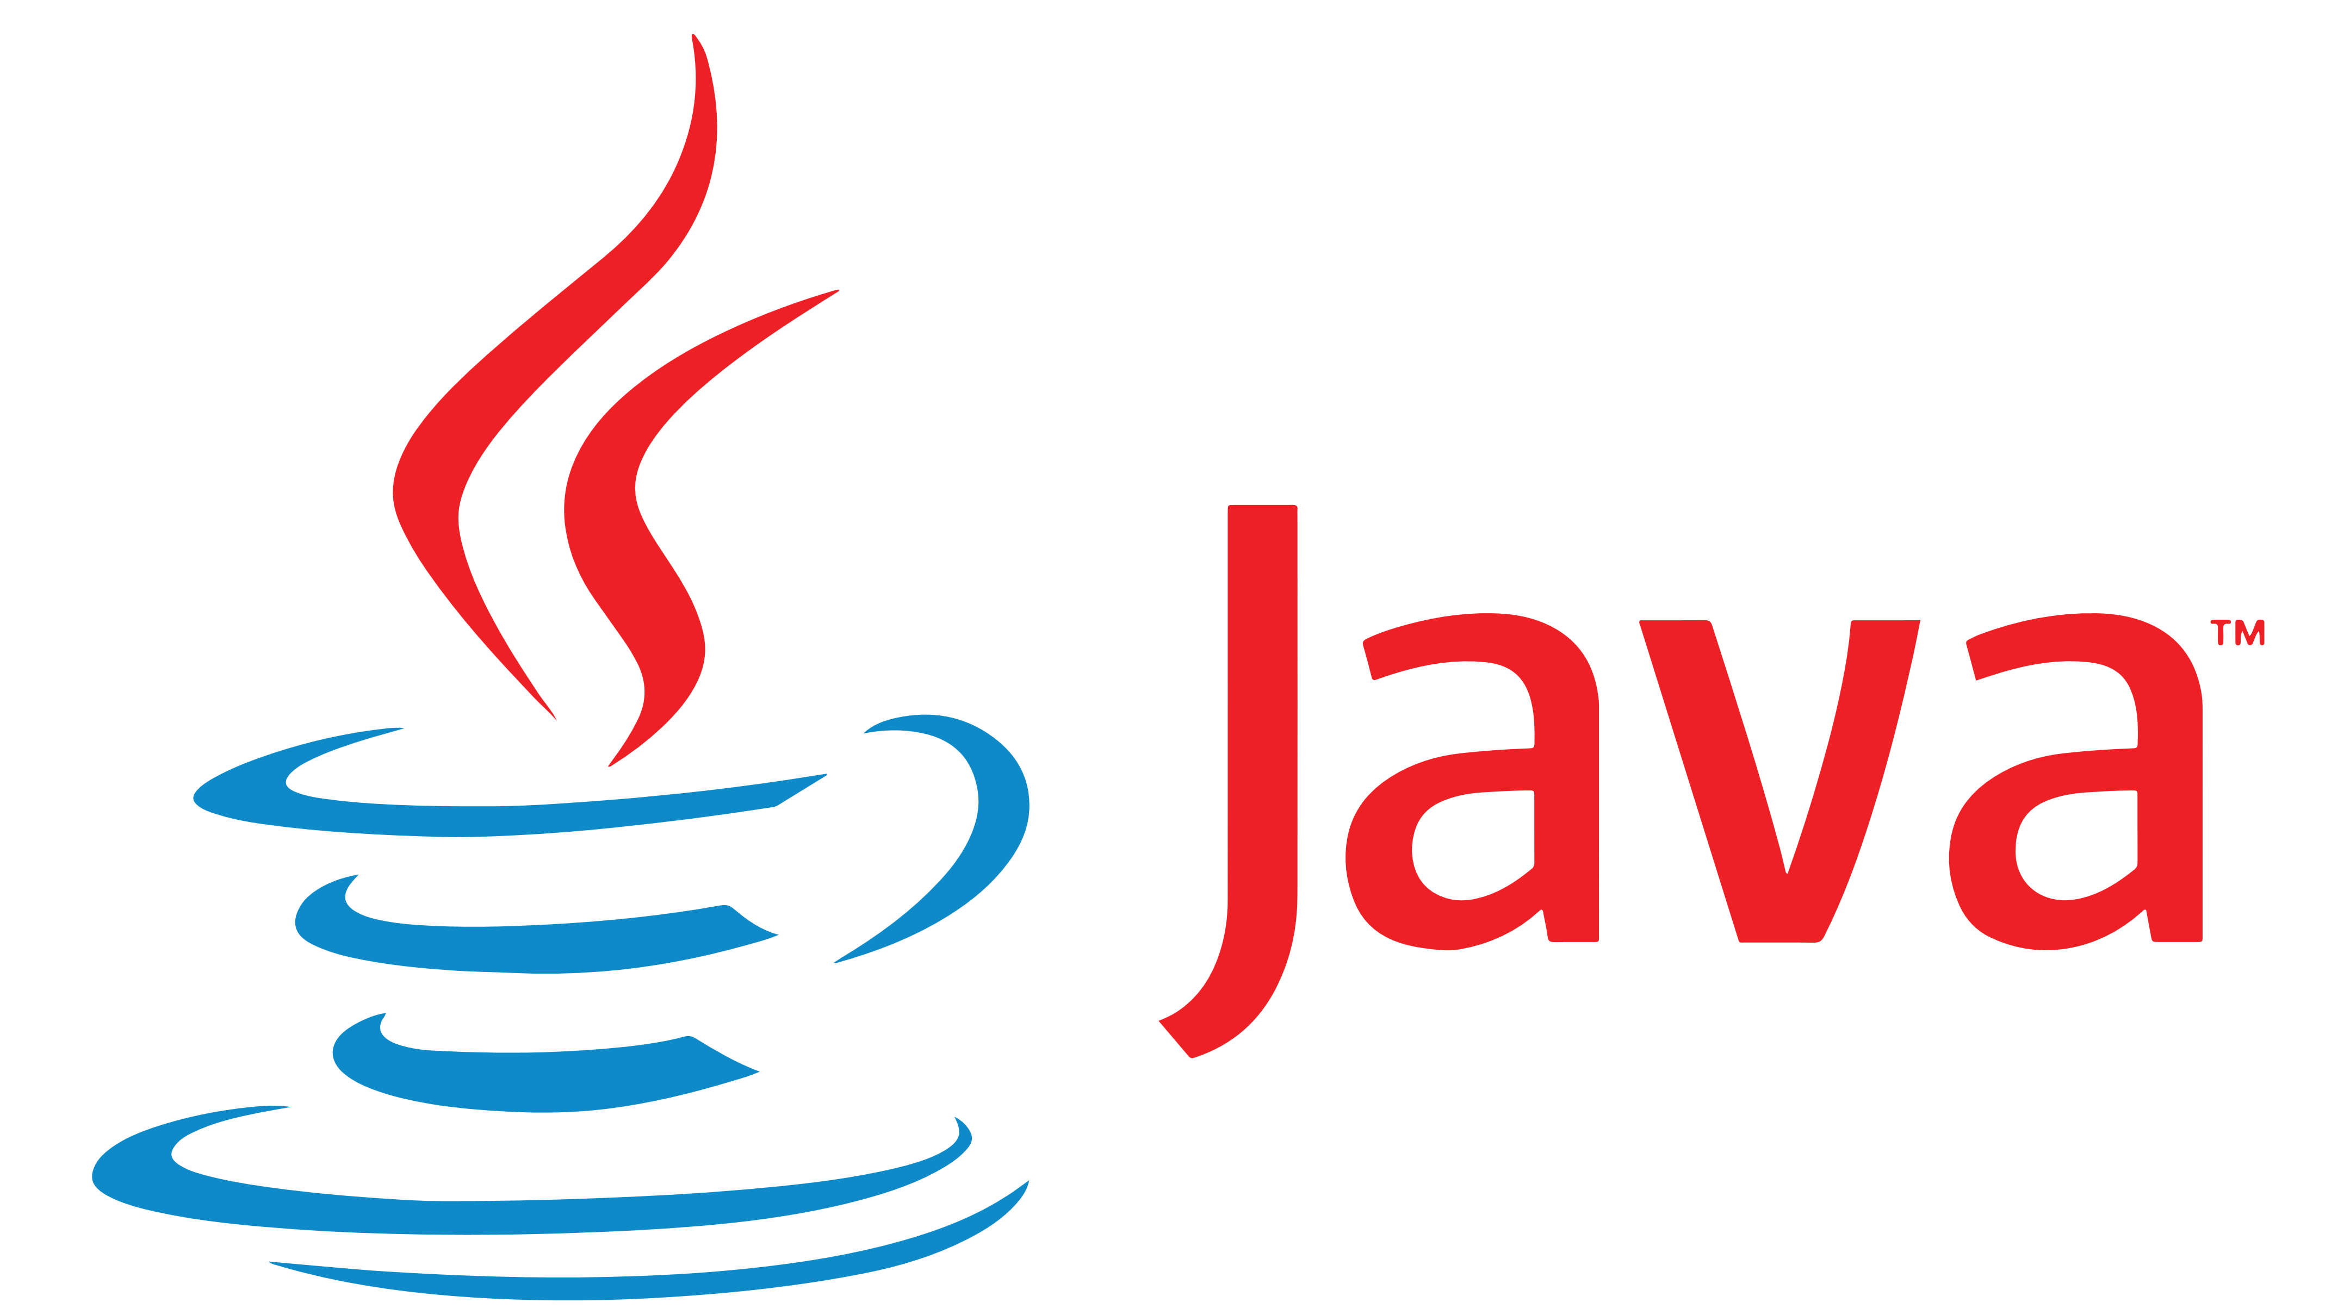
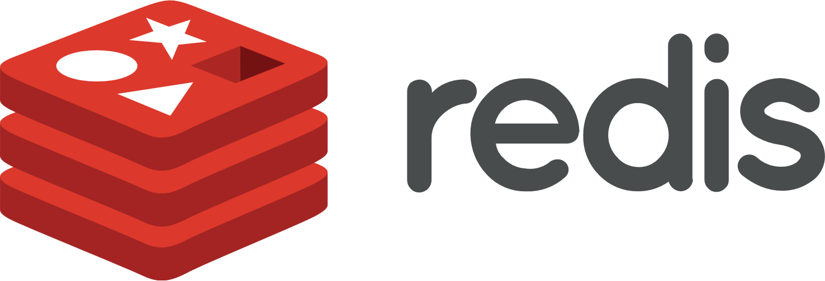


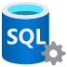


Integrations: Cloud Agnostic
Nuget Gallery | Home
https://www.nuget.org
Integrations: Azure
Integrations: AWS
Community Toolkit

Slide 17
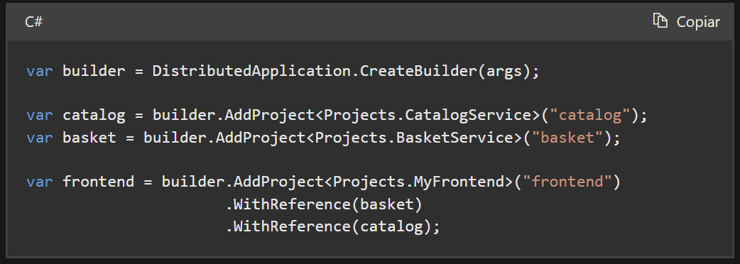
Service Discovery
Implicit service discovery by reference
Named endpoints
Notes:
El **service discovery** en .NET Aspire es una funcionalidad crucial que permite a las aplicaciones distribuidas encontrar y comunicarse entre sí de manera eficiente. Aquí tienes un resumen de sus características principales:
1. **Descubrimiento Implícito por Referencia**: La configuración para el descubrimiento de servicios se añade automáticamente para los servicios referenciados por un proyecto. Por ejemplo, si un proyecto frontend referencia a los servicios de catálogo y cesta, .NET Aspire pasa la información de descubrimiento de servicios a estos proyectos¹(https://learn.microsoft.com/en-us/dotnet/aspire/service-discovery/overview).
2. **Endpoints Nombrados**: Algunos servicios exponen múltiples endpoints nombrados. Estos pueden resolverse especificando el nombre del endpoint en la URI de la solicitud HTTP. Por ejemplo, si un servicio llamado "basket" expone un endpoint llamado "dashboard", la URI sería `https://_dashboard.basket`¹(https://learn.microsoft.com/en-us/dotnet/aspire/service-discovery/overview).
3. **Configuración Basada en Endpoints**: Los endpoints nombrados pueden especificarse en la configuración, como en un archivo `appsettings.json`. Esto permite definir endpoints predeterminados y nombrados para diferentes servicios¹(https://learn.microsoft.com/en-us/dotnet/aspire/service-discovery/overview).
4. **Integración con Kubernetes**: Al desplegar en Kubernetes, se pueden usar registros DNS SRV para resolver endpoints nombrados. Esto facilita la gestión de servicios en entornos de contenedores¹(https://learn.microsoft.com/en-us/dotnet/aspire/service-discovery/overview).
5. **Ejemplo de Código**: Aquí tienes un ejemplo de cómo se configura el descubrimiento de servicios en un proyecto AppHost:
```csharp
var builder = DistributedApplication.CreateBuilder(args);
var catalog = builder.AddProject<Projects.CatalogService>("catalog");
var basket = builder.AddProject<Projects.BasketService>("basket");
var frontend = builder.AddProject<Projects.MyFrontend>("frontend")
.WithReference(basket)
.WithReference(catalog);
```
En este ejemplo, el proyecto frontend referencia a los servicios de catálogo y cesta, y .NET Aspire gestiona automáticamente la información de descubrimiento de servicios¹(https://learn.microsoft.com/en-us/dotnet/aspire/service-discovery/overview).
El service discovery en .NET Aspire simplifica la configuración y gestión de servicios en aplicaciones distribuidas, asegurando que los servicios puedan encontrarse y comunicarse de manera eficiente.
¿Hay algún aspecto específico del service discovery que te gustaría explorar más a fondo?
¹(https://learn.microsoft.com/en-us/dotnet/aspire/service-discovery/overview): ¹(https://learn.microsoft.com/en-us/dotnet/aspire/service-discovery/overview)
Origen: Conversación con Copilot 22/11/2024
(1) .NET Aspire service discovery - .NET Aspire | Microsoft Learn. https://learn.microsoft.com/en-us/dotnet/aspire/service-discovery/overview.

Slide 18
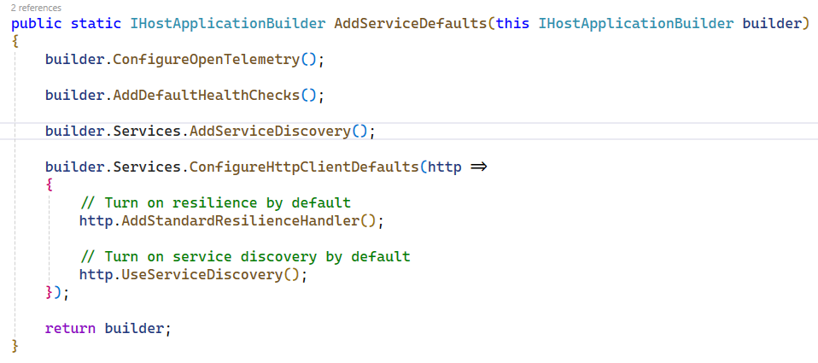
Service Defaults

Slide 19

Health Checks
Health
Alive

Slide 20
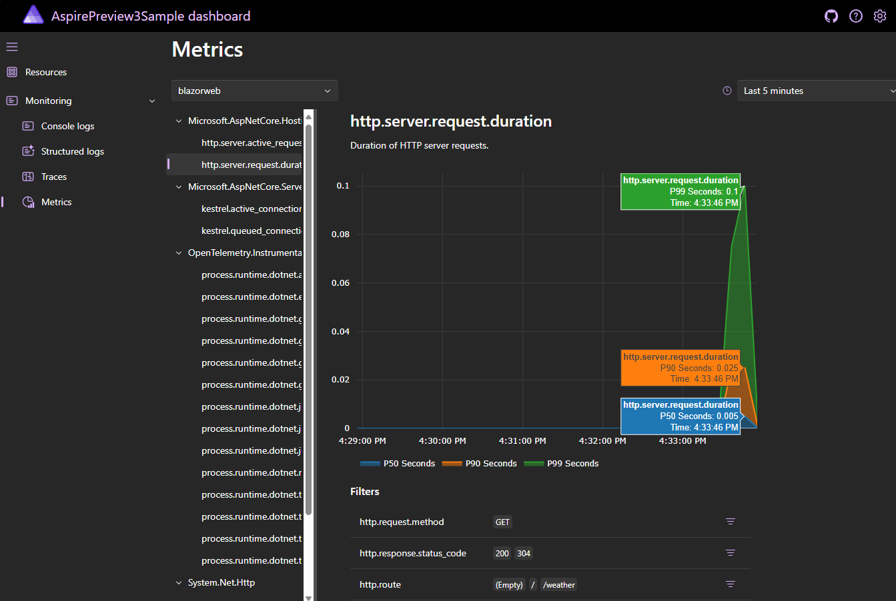
Telemetry
Resources
Monitoring
Console logs
Structured logs
Traces
Metrics

Slide 21
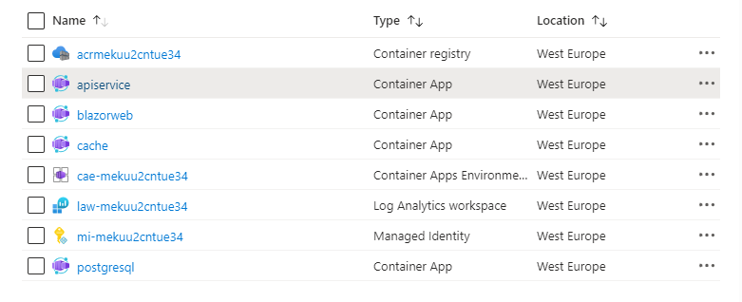
Deploy to Azure
Notes:
azd init

Slide 22
.NET Aspire
Engage with team on GitHub
aka.ms/dotnet-aspire
github.com/dotnet/aspire

Slide 23
GET .NET TODAY
Download .NET 8 aka.ms/get-dotnet-8
Download .NET 9 aka.ms/get-dotnet-9

Slide 24
DAPR (Distributed Application Runtime)
https://dapr.io/

Slide 25
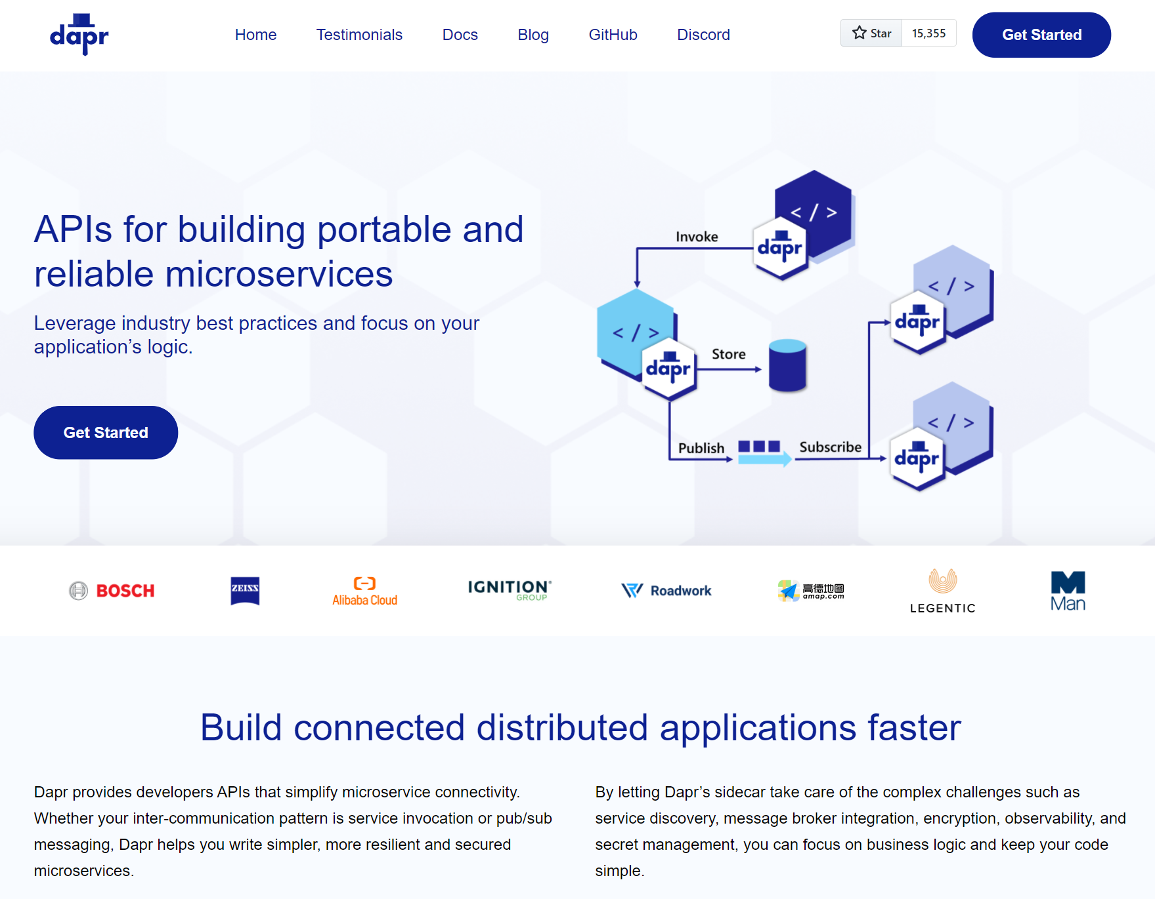

Distributed Application Runtime
dapr.io
Notes:
Dapr: Distributed Application Runtime
Es un conjunto de APIs que permiten a los desarrolladores implementar aplicaciones de microservicios portables y confiables.
Podemos trabajar con
State Management.
Secretos.
Patrón pub/sub.
Etc…
El objetivo de Dapr es proporcionar fiabilidad, resiliencia a través de reintentos, marcha atrás, circuit breaker. Las comunicaciones están son seguras, ya que se encuentran encriptadas mTLS. Al final tenemos una aplicación realmente portable

Slide 26
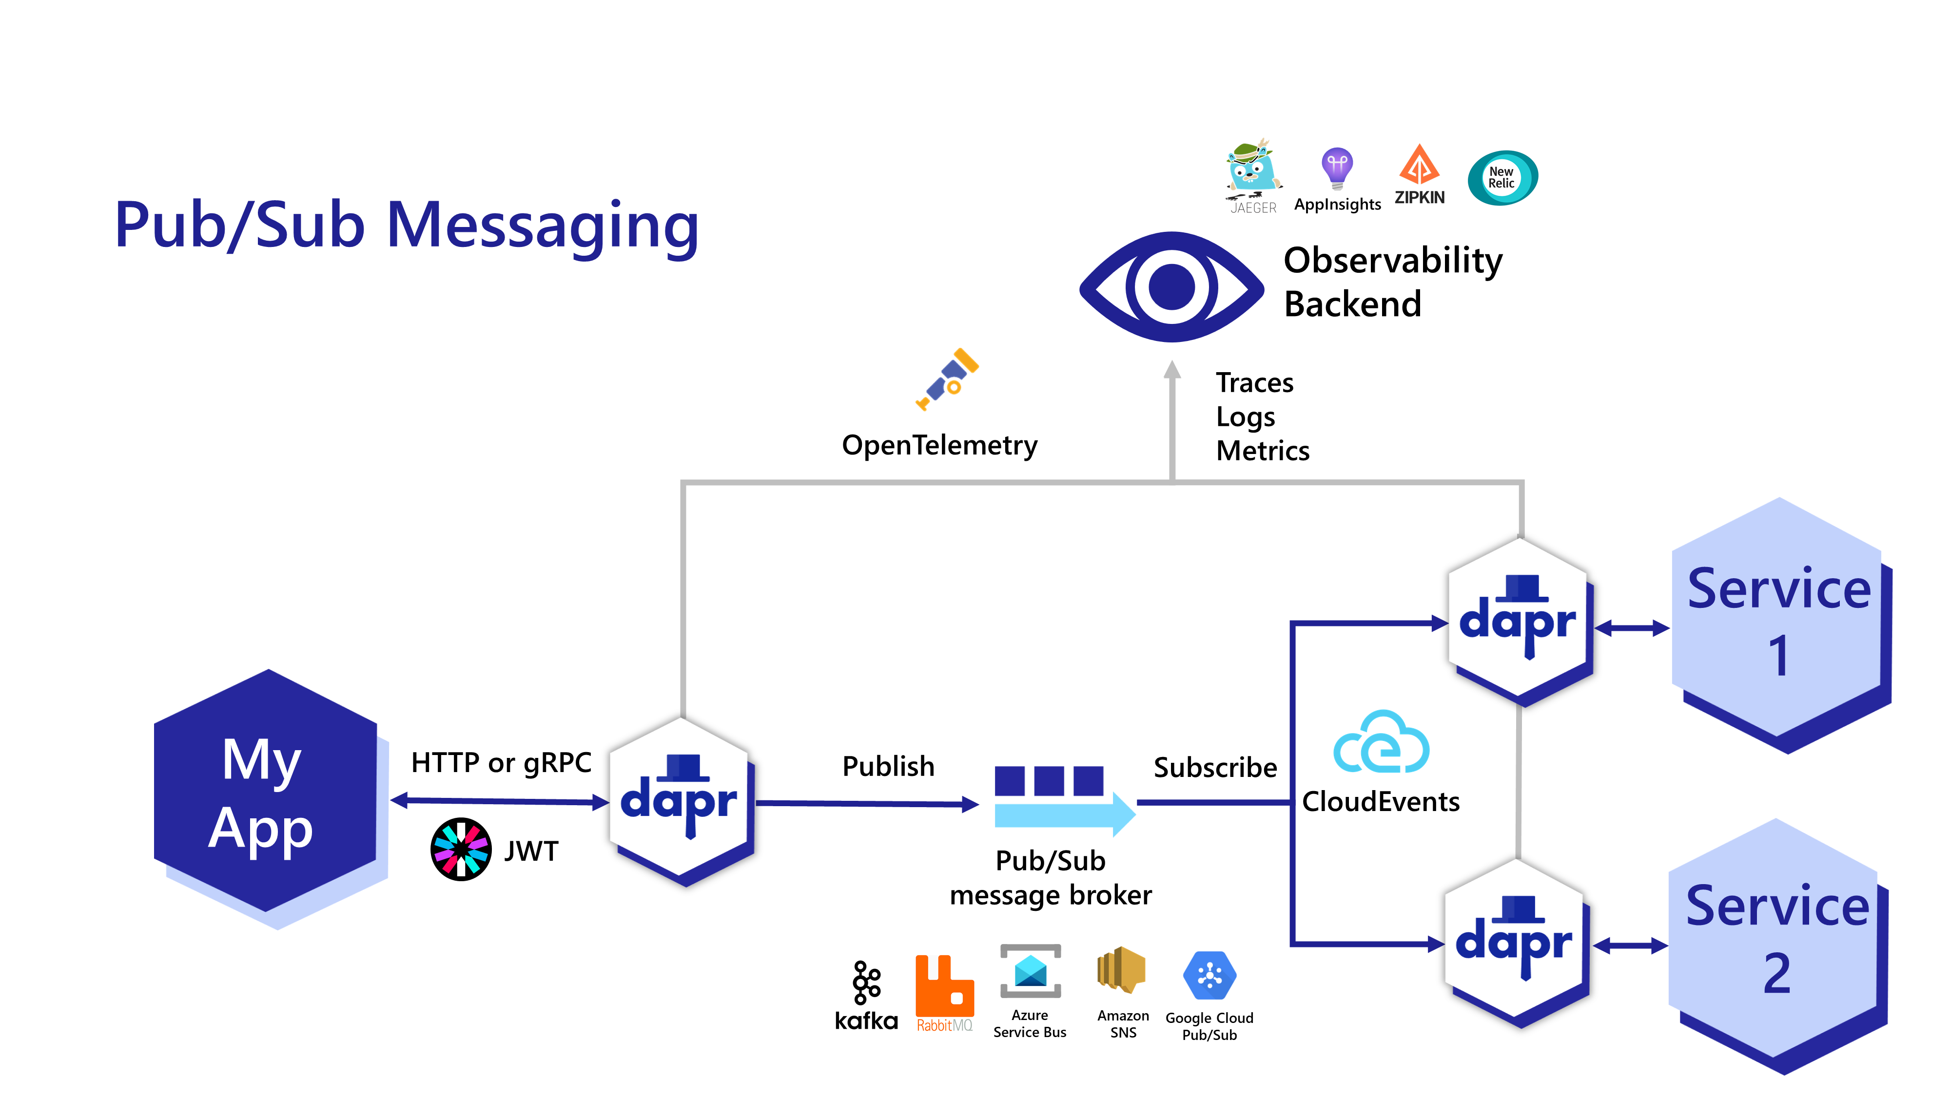
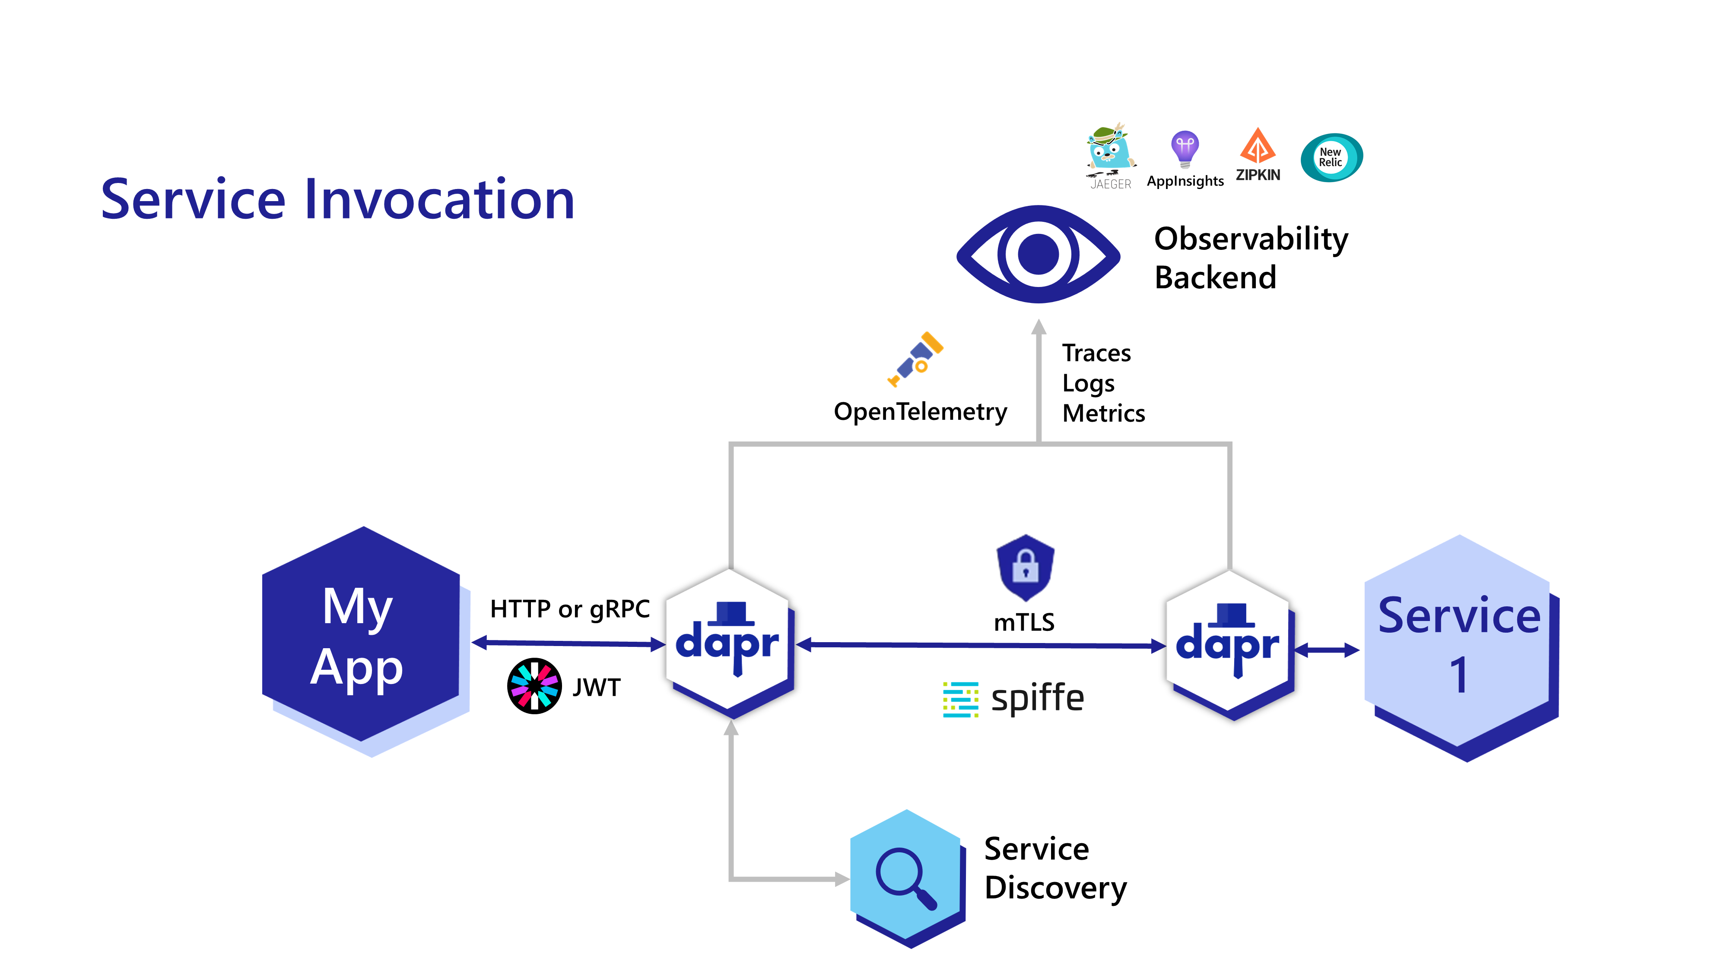
Build connected distributed applications faster
APIs for building microservices easily
Resiliency built-in
Message and event broker integrations
Service discovery
mTLS encryption
Secrets
..thanks to sidecar process

Slide 27

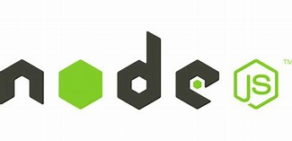


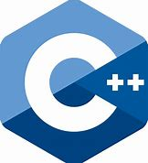

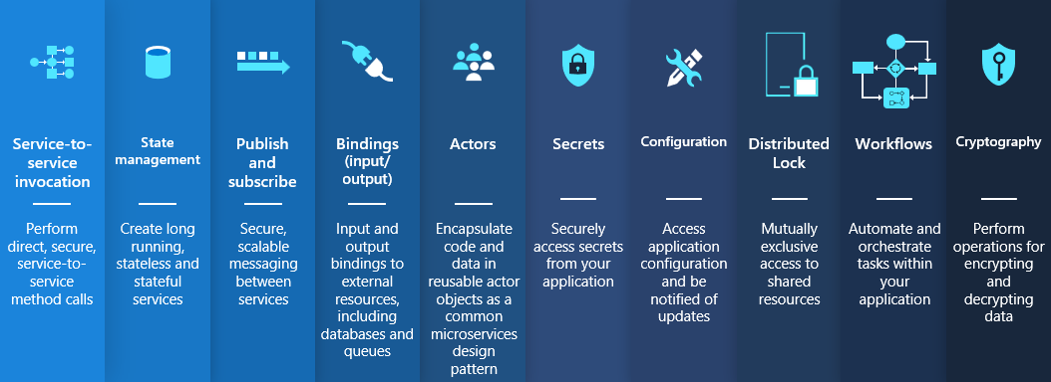
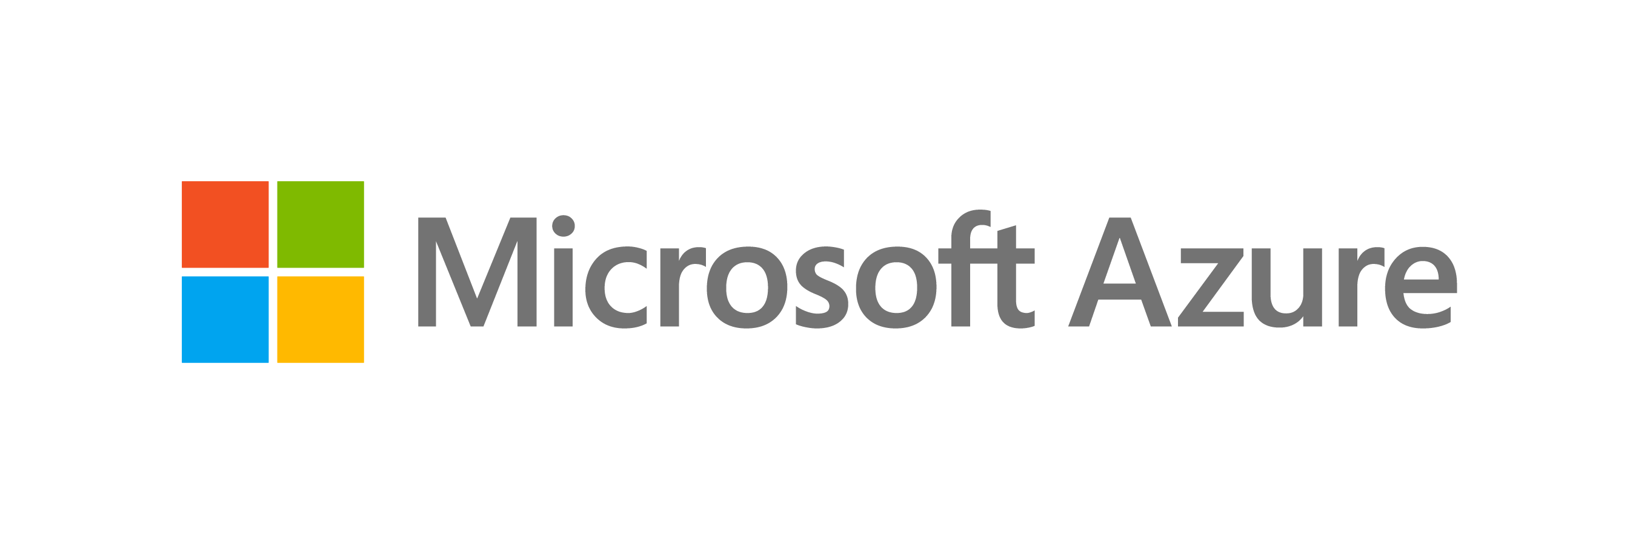



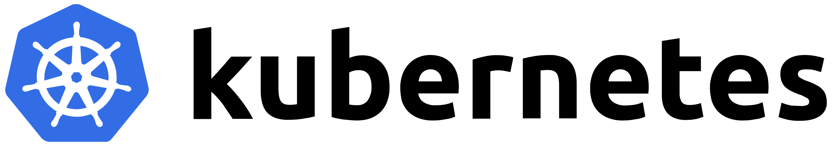


Any cloud or edge infrastructure
Application code
Microservices written in
Any code or framework…
HTTP API
gRPC API
Hosting infrastructure
Azure Arc
On-Premises

Slide 28
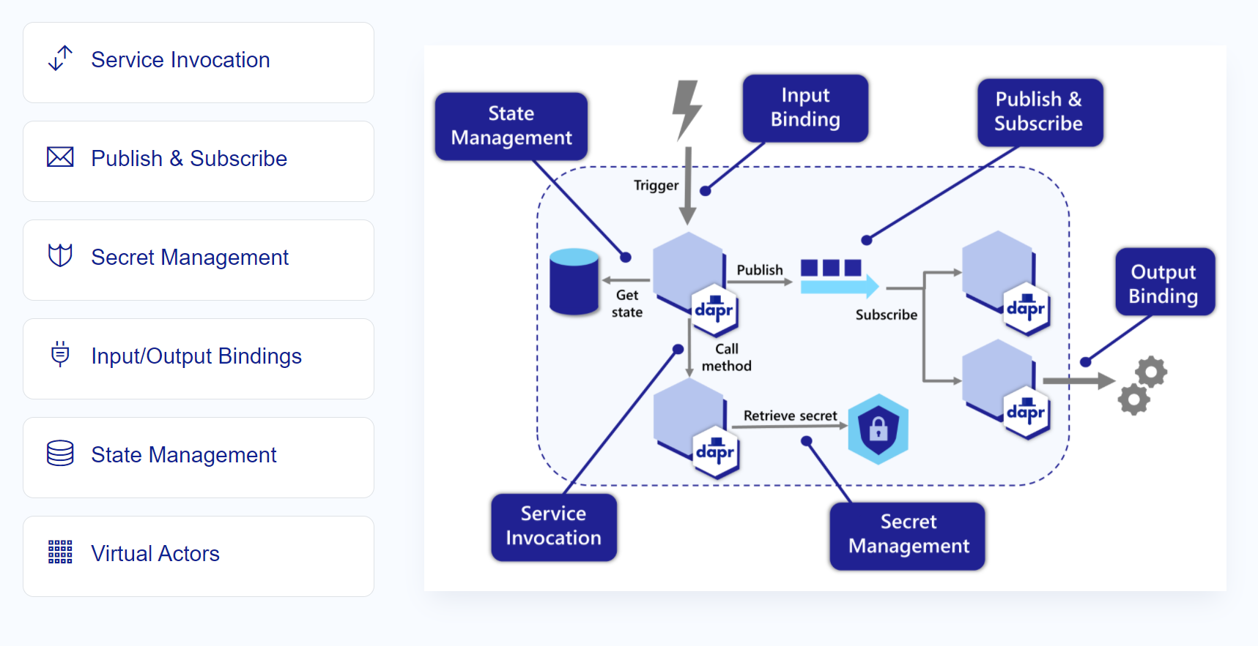
APIs for solving microservices challenges
Notes:
Service-to-service invocation Service invocation enables applications to communicate with each other through well-known endpoints in the form of http or gRPC messages. Dapr provides an endpoint that acts as a combination of a reverse proxy with built-in service discovery, while leveraging built-in distributed tracing and error handling.
State management Application state is anything an application wants to preserve beyond a single session. Dapr provides a key/value-based state and query APIs with pluggable state stores for persistence.
Publish and subscribe Pub/Sub is a loosely coupled messaging pattern where senders (or publishers) publish messages to a topic, to which subscribers subscribe. Dapr supports the pub/sub pattern between applications.
Bindings A binding provides a bi-directional connection to an external cloud/on-premise service or system. Dapr allows you to invoke the external service through the Dapr binding API, and it allows your application to be triggered by events sent by the connected service.
Actors An actor is an isolated, independent unit of compute and state with single-threaded execution. Dapr provides an actor implementation based on the virtual actor pattern which provides a single-threaded programming model and where actors are garbage collected when not in use.
Observability Dapr system components and runtime emit metrics, logs, and traces to debug, operate and monitor Dapr system services, components and user applications.
Secrets Dapr provides a secrets building block API and integrates with secret stores such as public cloud stores, local stores and Kubernetes to store the secrets. Services can call the secrets API to retrieve secrets, for example to get a connection string to a database.
Configuration The Configuration API enables you to retrieve and subscribe to application configuration items for supported configuration stores. This enables an application to retrieve specific configuration information, for example, at start up or when configuration changes are made in the store.
Distributed lock The distributed lock API enables you to take a lock on a resource so that multiple instances of an application can access the resource without conflicts and provide consistency guarantees.
Workflows The Workflow API enables you to define long running, persistent processes or data flows that span multiple microservices using Dapr workflows or workflow components. The Workflow API can be combined with other Dapr API building blocks. For example, a workflow can call another service with service invocation or retrieve secrets, providing flexibility and portability.

Slide 29

Sidecar model
Application
Dapr sidecar
My App
Dapr API
HTTP/gRPC
POST http://localhost:3500/v1.0/invoke/cart/method/neworder
GET http://localhost:3500/v1.0/state/inventory/item67
POST http://localhost:3500/v1.0/publish/shipping/orders
GET http://localhost:3500/v1.0/secrets/keyvault/password
POST http://localhost:3500/v1.0-beta1/workflows/dapr/businessprocess/1234/start

Slide 30
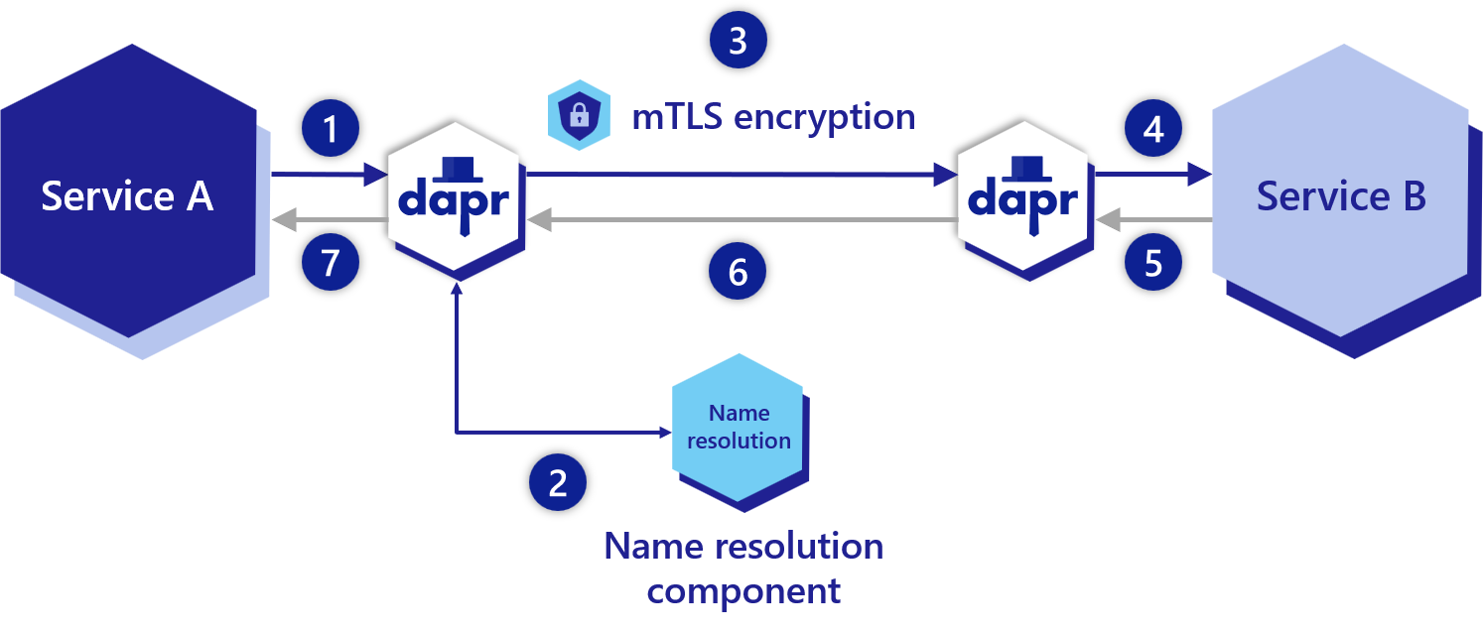
Sidecar model (Service-To-Service Invocation)
Notes:
Overview of the service invocation API building block
Using service invocation, your application can reliably and securely communicate with other applications using the standard gRPC or HTTP protocols.
In many microservice-based applications, multiple services need the ability to communicate with one another. This inter-service communication requires that application developers handle problems like:
Service discovery. How do I discover my different services?
Standardizing API calls between services. How do I invoke methods between services?
Secure inter-service communication. How do I call other services securely with encryption and apply access control on the methods?
Mitigating request timeouts or failures. How do I handle retries and transient errors?
Implementing observability and tracing. How do I use tracing to see a call graph with metrics to diagnose issues in production?

Slide 31
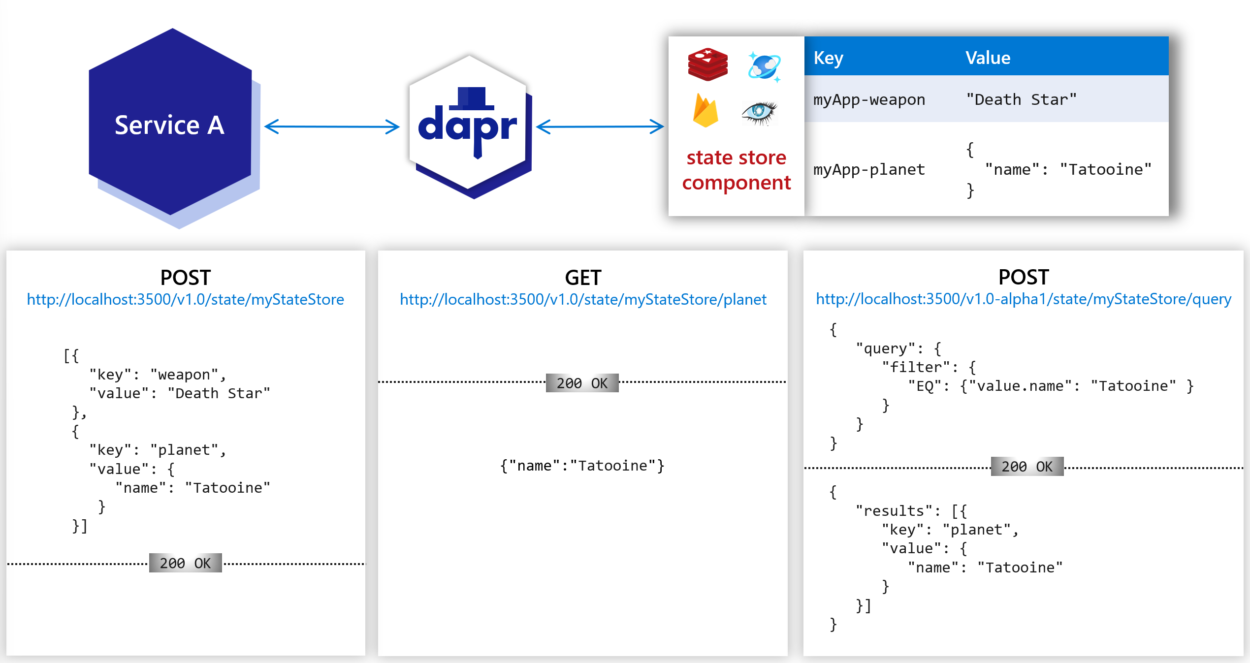
Sidecar model (State management)
Notes:
Overview of the state management API building block
Your application can use Dapr’s state management API to save, read, and query key/value pairs in the supported state stores. Using a state store component, you can build stateful, long running applications that save and retrieve their state (like a shopping cart or a game’s session state). For example, in the diagram below:
Use HTTP POST to save or query key/value pairs.
Use HTTP GET to read a specific key and have its value returned.

Slide 32
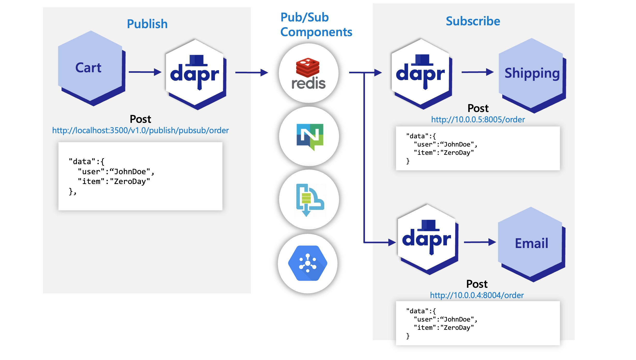
Sidecar model (Publish and Subscribe)
Notes:
Overview of the pub/sub API building block
Publish and subscribe (pub/sub) enables microservices to communicate with each other using messages for event-driven architectures.
The producer, or publisher, writes messages to an input channel and sends them to a topic, unaware which application will receive them.
The consumer, or subscriber, subscribes to the topic and receives messages from an output channel, unaware which service produced these messages.
An intermediary message broker copies each message from a publisher’s input channel to an output channel for all subscribers interested in that message. This pattern is especially useful when you need to decouple microservices from one another.

Slide 33
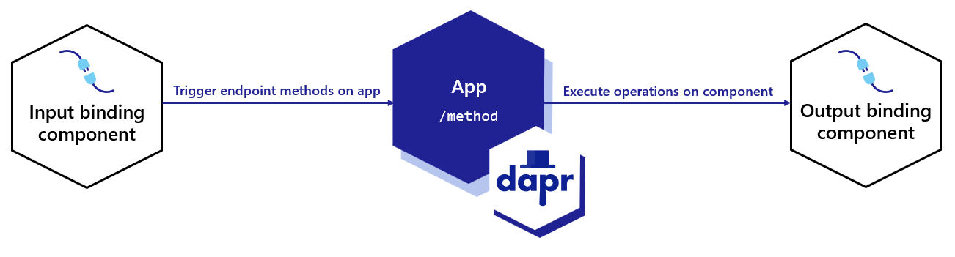
Sidecar model (Bindings)
Notes:
Overview of the bindings API building block
Using Dapr’s bindings API, you can trigger your app with events coming in from external systems and interface with external systems. With the bindings API, you can:
Avoid the complexities of connecting to and polling from messaging systems, such as queues and message buses.
Focus on business logic, instead of the implementation details of interacting with a system.
Keep your code free from SDKs or libraries.
Handle retries and failure recovery.
Switch between bindings at runtime.
Build portable applications with environment-specific bindings set-up and no required code changes.
For example, with bindings, your application can respond to incoming Twilio/SMS messages without:
Adding or configuring a third-party Twilio SDK
Worrying about polling from Twilio (or using WebSockets, etc.)

Slide 34
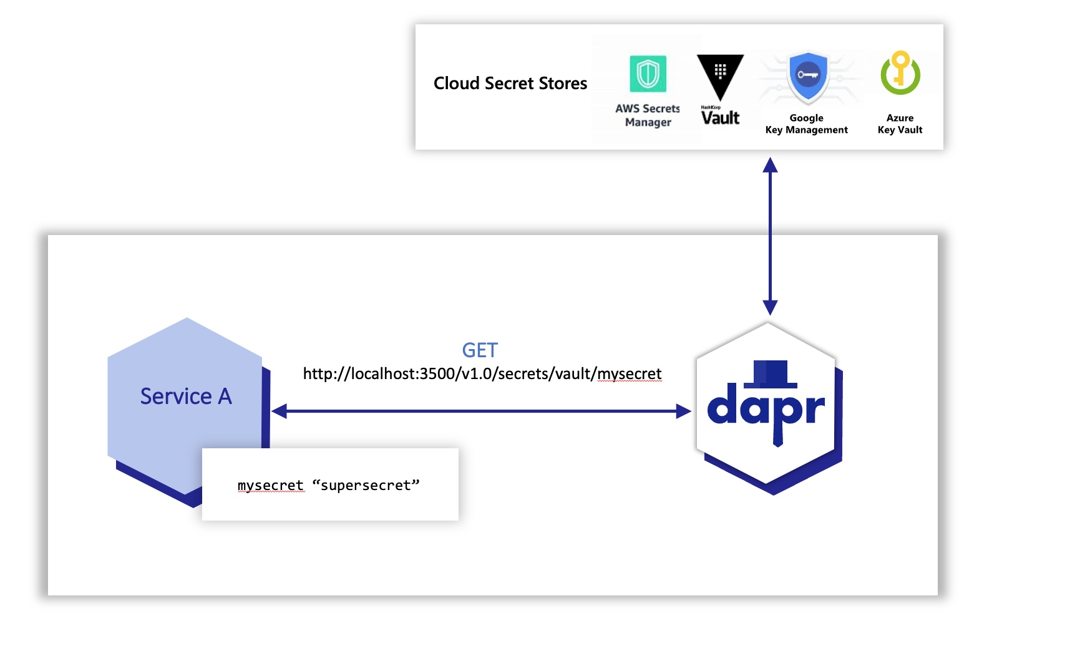
Sidecar model (Secret management)
Notes:
Overview of secrets management API building block
Applications usually store sensitive information in secrets by using a dedicated secret store. For example, you authenticate databases, services, and external systems with connection strings, keys, tokens, and other application-level secrets stored in a secret store, such as AWS Secrets Manager, Azure Key Vault, Hashicorp Vault, etc.
To access these secret stores, the application imports the secret store SDK, often requiring a fair amount of unrelated boilerplate code. This poses an even greater challenge in multi-cloud scenarios, where different vendor-specific secret stores may be used.

Slide 35
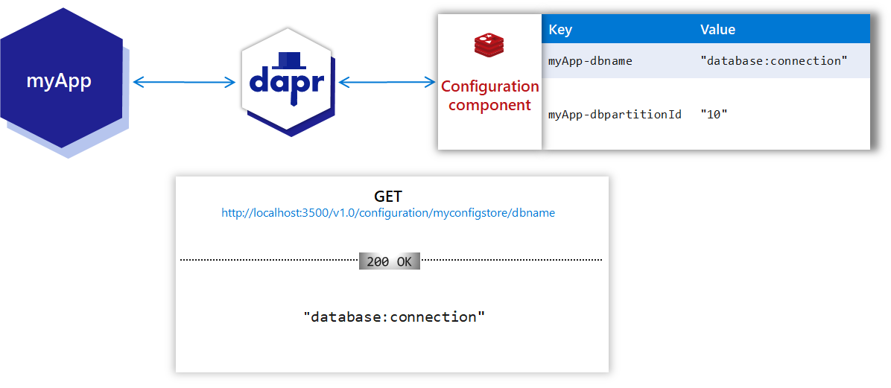
Sidecar model (Configuration)
Notes:
Overview of the configuration API building block
Consuming application configuration is a common task when writing applications. Frequently, configuration stores are used to manage this configuration data. A configuration item is often dynamic in nature and tightly coupled to the needs of the application that consumes it.
For example, application configuration can include:
Names of secrets
Different identifiers
Partition or consumer IDs
Names of databases to connect to, etc
Usually, configuration items are stored as key/value items in a state store or database. Developers or operators can change application configuration at runtime in the configuration store. Once changes are made, a service is notified to load the new configuration.
Configuration data is read-only from the application API perspective, with updates to the configuration store made through operator tooling. With Dapr’s configuration API, you can:
Consume configuration items that are returned as read-only key/value pairs
Subscribe to changes whenever a configuration item changes

Slide 36
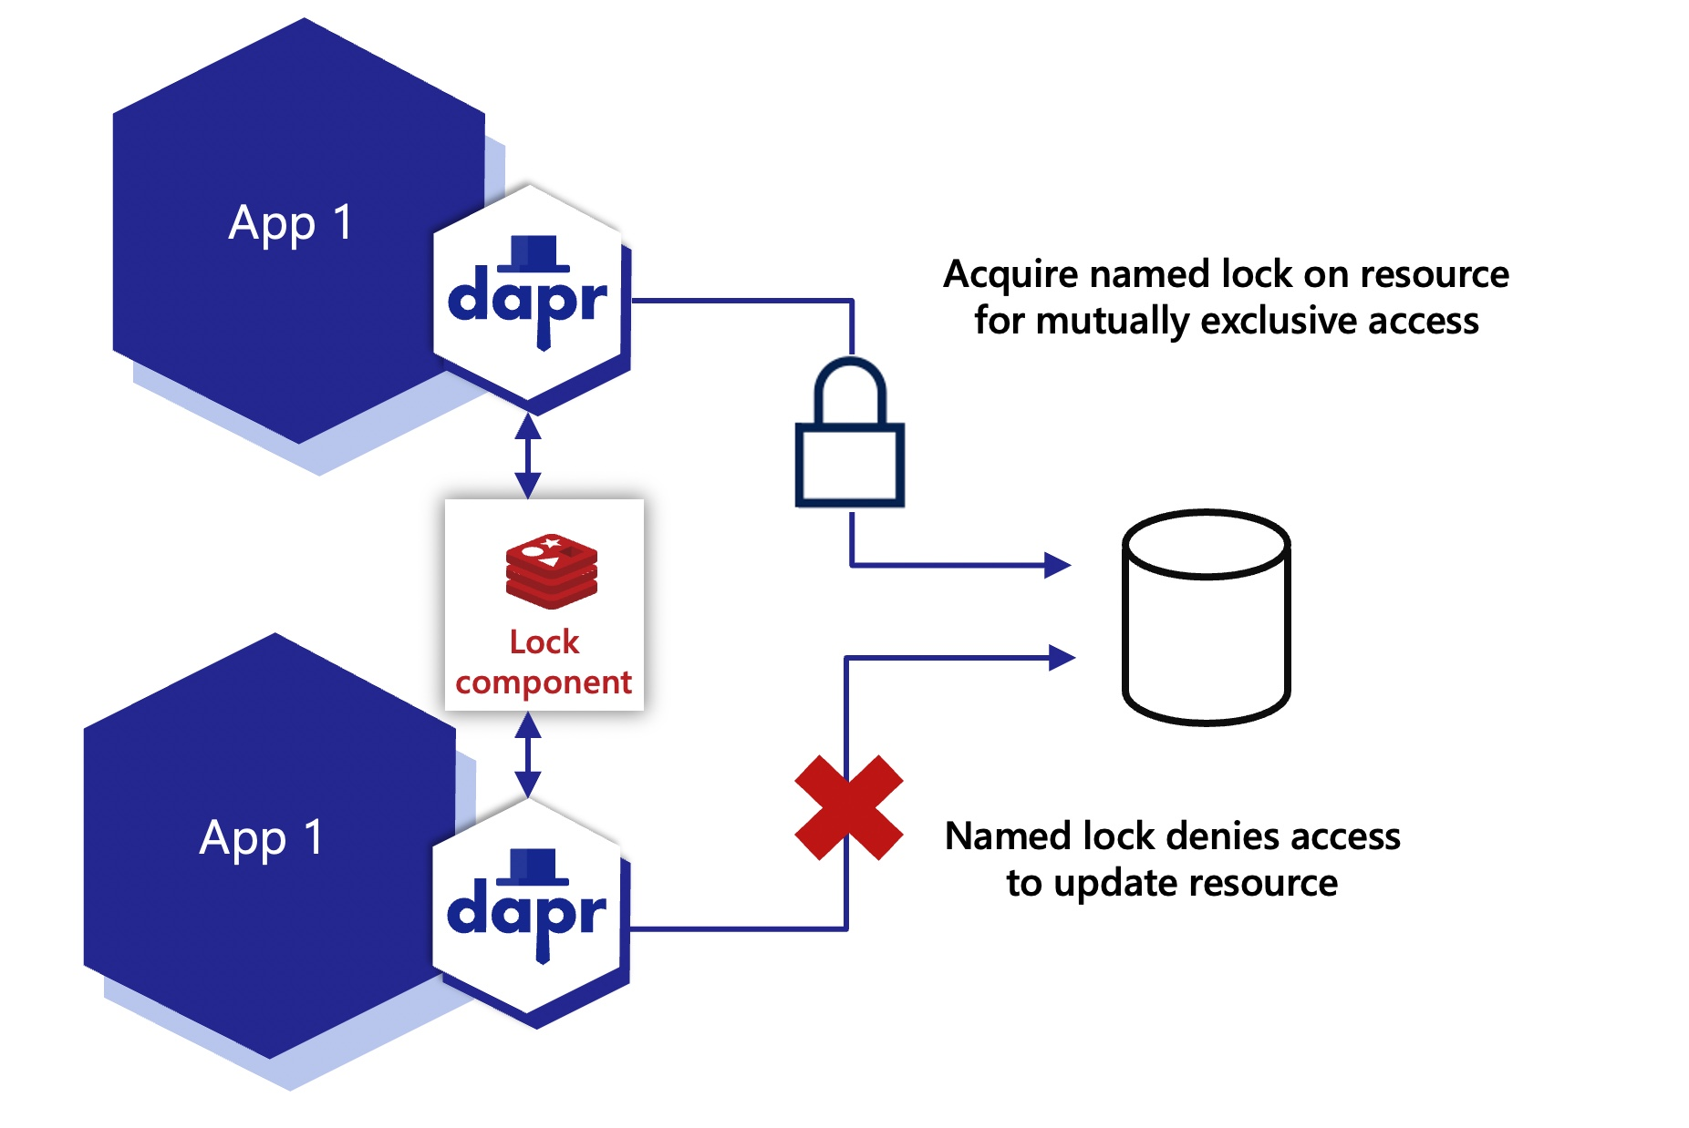
Sidecar model (Distributed lock)
Notes:
Overview of the distributed lock API building block
Locks are used to provide mutually exclusive access to a resource. For example, you can use a lock to:
Provide exclusive access to a database row, table, or an entire database
Lock reading messages from a queue in a sequential manner
Any resource that is shared where updates occur can be the target for a lock. Locks are usually used on operations that mutate state, not on reads.
Each lock has a name. The application determines the resources that the named lock accesses. Typically, multiple instances of the same application use this named lock to exclusively access the resource and perform updates.
For example, in the competing consumer pattern, multiple instances of an application access a queue. You can decide that you want to lock the queue while the application is running its business logic.
In the diagram below, two instances of the same application, App1, use the Redis lock component to take a lock on a shared resource.
The first app instance acquires the named lock and gets exclusive access.
The second app instance is unable to acquire the lock and therefore is not allowed to access the resource until the lock is released, either:
Explicitly by the application through the unlock API, or
After a period of time, due to a lease timeout.

Slide 37
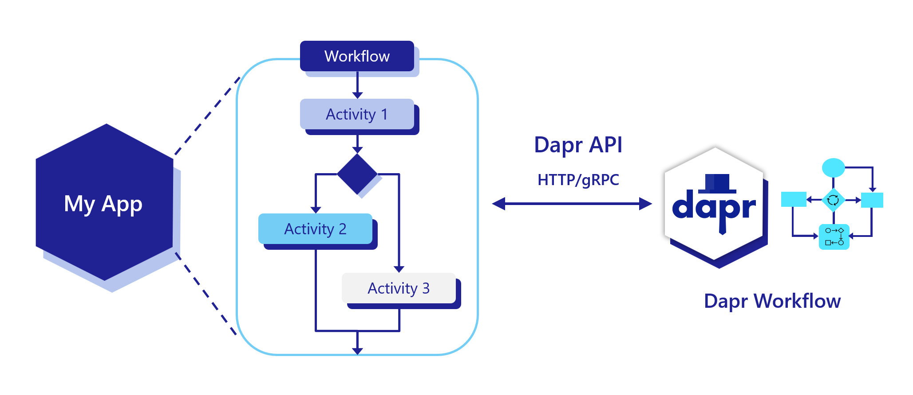
Sidecar model (Workflow)
Notes:
Overview of Dapr Workflow
Dapr workflow makes it easy for developers to write business logic and integrations in a reliable way. Since Dapr workflows are stateful, they support long-running and fault-tolerant applications, ideal for orchestrating microservices. Dapr workflow works seamlessly with other Dapr building blocks, such as service invocation, pub/sub, state management, and bindings.
The durable, resilient Dapr Workflow capability:
Offers a built-in workflow runtime for driving Dapr Workflow execution.
Provides SDKs for authoring workflows in code, using any language.
Provides HTTP and gRPC APIs for managing workflows (start, query, pause/resume, raise event, terminate, purge).
Integrates with any other workflow runtime via workflow components.

Slide 38
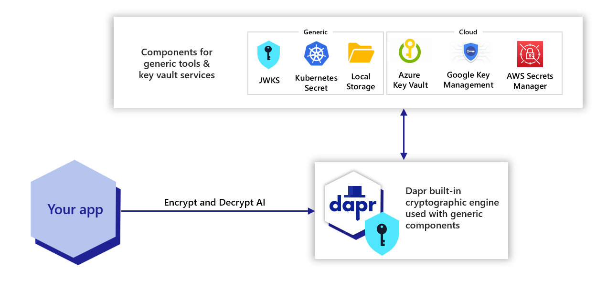
Sidecar model (Cryptography)
Notes:
Overview of Dapr Cryptography
With the cryptography building block, you can leverage cryptography in a safe and consistent way.
Dapr exposes APIs that allow you to perform operations, such as encrypting and decrypting messages, within key vaults or the Dapr sidecar, without exposing cryptographic keys to your application

Slide 39
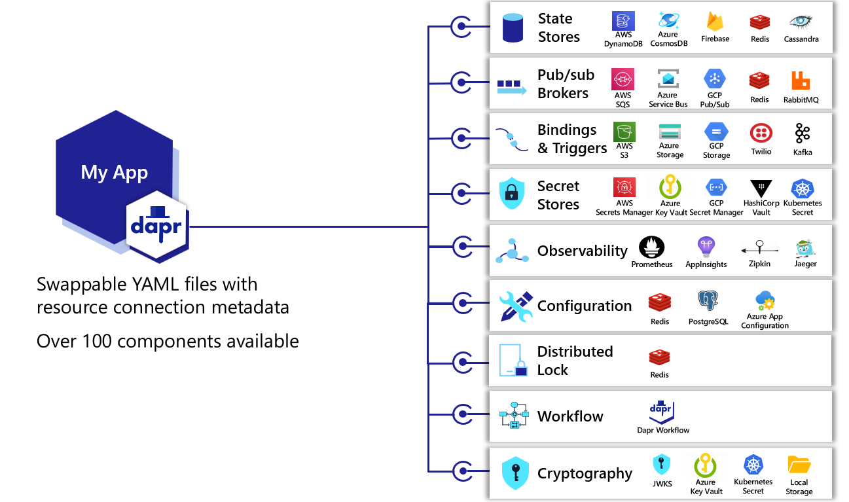
Dapr components

Slide 40
Industry established best practices for reliability
Secured connections (mTLS)
Resilient state
Retries, backoffs, circuit breakers
Message guarantees
Observability

Slide 41
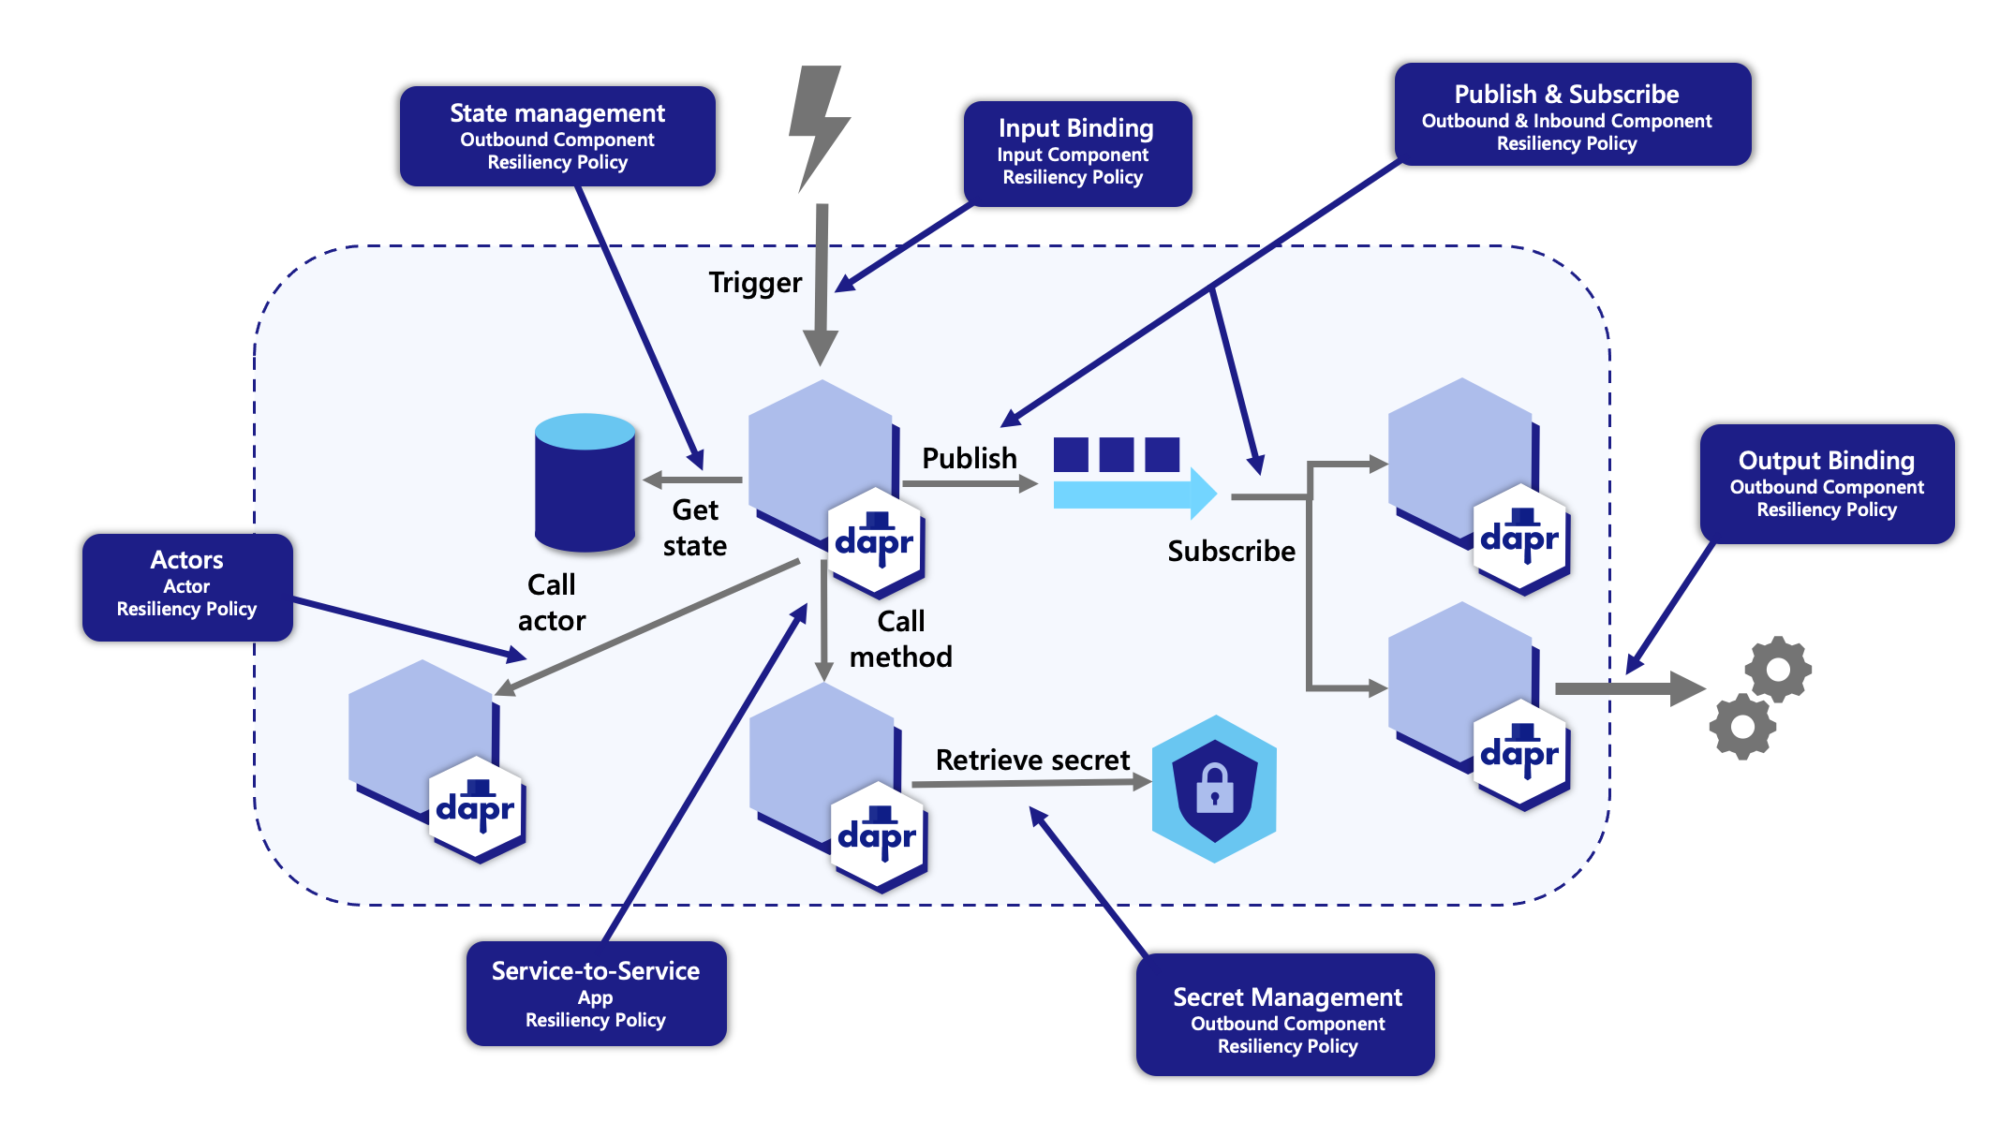
Cross-cutting (Resiliency)
Notes:
Configure policies and monitor app and sidecar health
Distributed applications are commonly comprised of many microservices, with dozens - sometimes hundreds - of instances scaling across underlying infrastructure.
As these distributed solutions grow in size and complexity, the potential for system failures inevitably increases.
Service instances can fail or become unresponsive due to any number of issues, including hardware failures, unexpected throughput, or application lifecycle events, such as scaling out and application restarts. Designing and implementing a self-healing solution with the ability to detect, mitigate, and respond to failure is critical

Slide 42
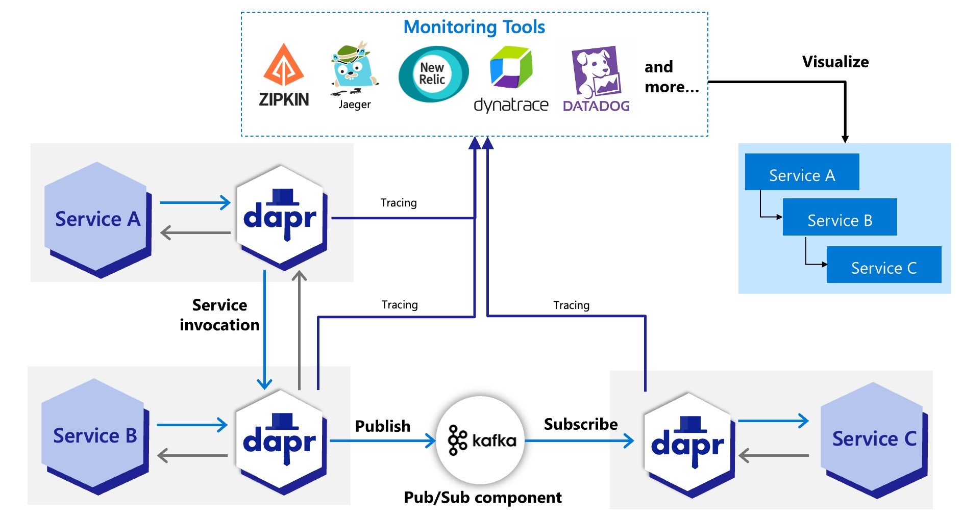
Cross-cutting (Observability)
Notes:
Observe applications through tracing, metrics, logs and health
When building an application, understanding the system behavior is an important, yet challenging part of operating it, such as:
Observing the internal calls of an application
Gauging its performance
Becoming aware of problems as soon as they occur
This can be particularly challenging for a distributed system comprised of multiple microservices, where a flow made of several calls may start in one microservice and continue in another.
Observability into your application is critical in production environments, and can be useful during development to:
Understand bottlenecks
Improve performance
Perform basic debugging across the span of microservices
While some data points about an application can be gathered from the underlying infrastructure (memory consumption, CPU usage), other meaningful information must be collected from an “application-aware” layer – one that can show how an important series of calls is executed across microservices. Typically, you’d add some code to instrument an application, which simply sends collected data (such as traces and metrics) to observability tools or services that can help store, visualize, and analyze all this information.
Maintaining this instrumentation code, which is not part of the core logic of the application, requires understanding the observability tools’ APIs, using additional SDKs, etc.
This instrumentation may also present portability challenges for your application, requiring different instrumentation depending on where the application is deployed.
For example:
Different cloud providers offer different observability tools
An on-premises deployment might require a self-hosted solution

Slide 43
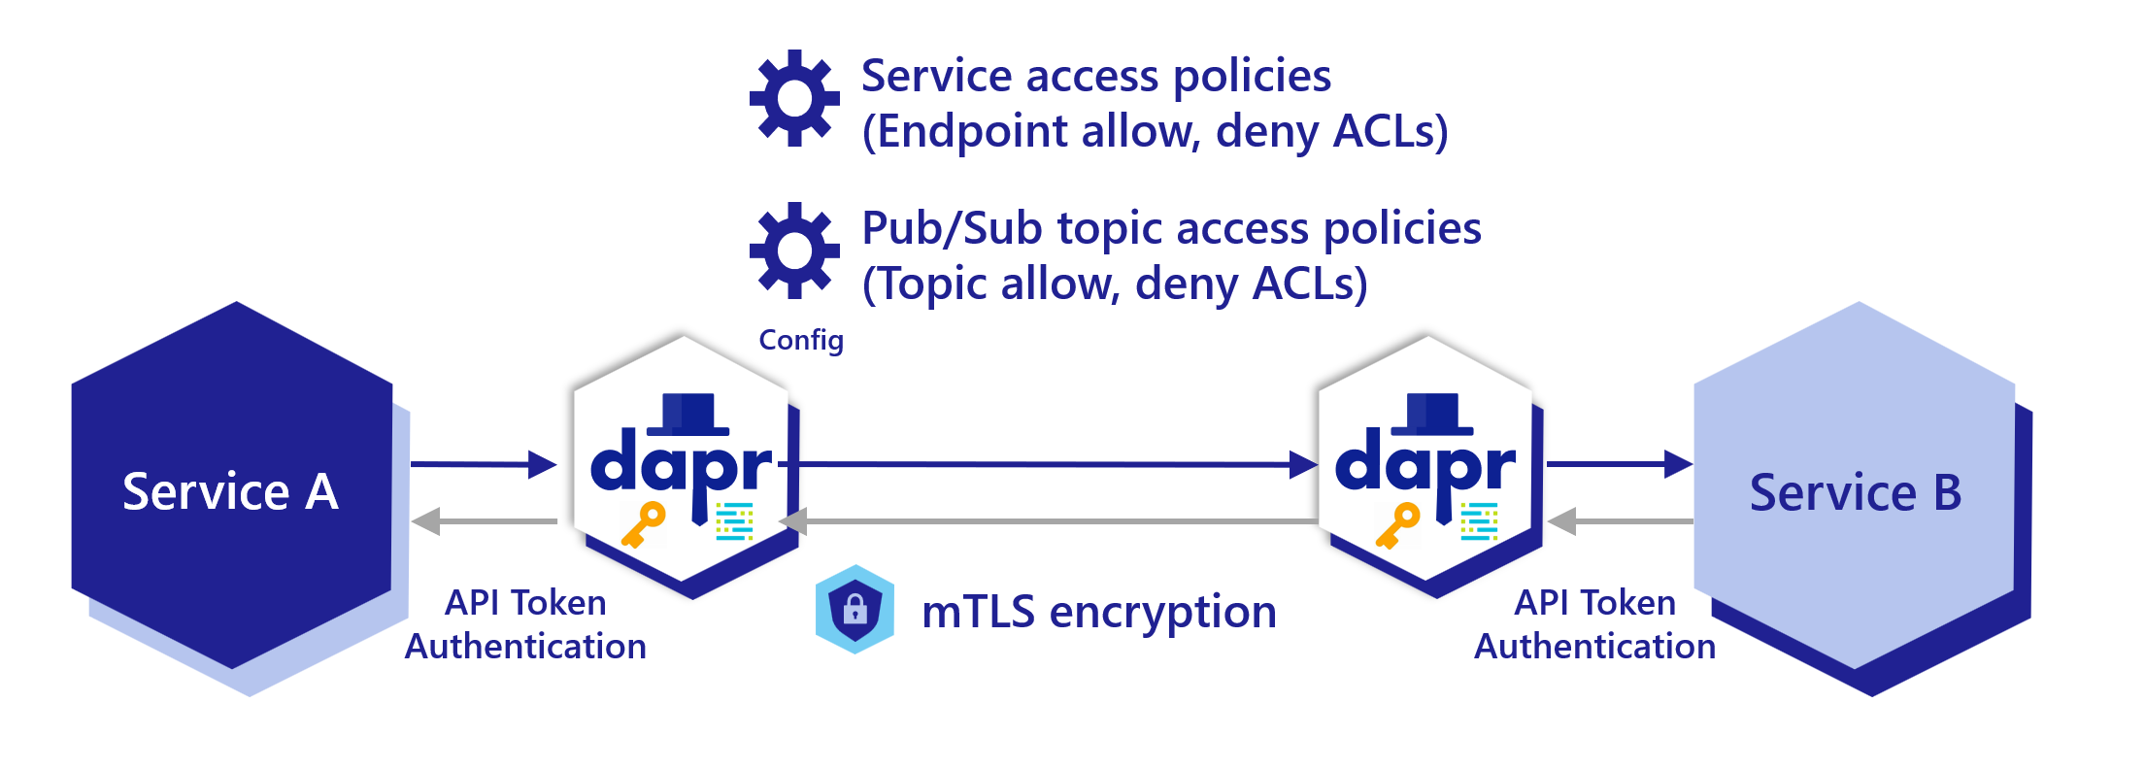
Cross-cutting (Security)
Notes:
Security is fundamental to Dapr. This article describes the security features and capabilities when using Dapr in a distributed application.
These can be divided into:
Secure communication with service invocation and pub/sub APIs.
Security policies on components and applied through configuration.
Operational security practices.
State security, focusing on data at rest.

Slide 45

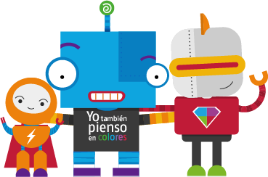



ENCAMINA
Para que estemos en contacto puedes seguirnos en:
ENCAMINA
@ENCAMINA
ENCAMINA_PIENSAENCOLORES
ENCAMINA_PIENSA_EN_COLORES

